Slide 1
Overview
ver.1.0
Exastro developer

Slide 2
Introduction – What is “Offensive” and “ Defensive” Automation?
When Virtualization technology was still undeveloped and young…
In order to avoid services stopping「Highest traffic x buffers x 2x redundancy」 were physically arranged.
Additionally, there were few options for what kind of CPU, Memory and I/O to use, Resulting in resources not being fully used.
Even so, it was considered “correct” to intergrate multiple functions in order to handle a large number of services with as few devices as possible
As a result, Apps were built on this premise.
Hard to incorporate new technology
Tightly grouped applications
Traditional static Environments
Manual Construction/Operation
Monolithic
(Physical Machines)

Slide 3
Introduction – What is “Offensive” and “ Defensive” Automation?
Thanks to virtualization technology...
We can now freely select CPU, Memory and I/O
It is now possible to create Simple Dynamic systems easily
The size of the systems became more compact and we could get rid of end-of-life hardware.
Not mixing multiple functions became the “correct” thing to do.
However, The following issues remains unsolved
Many function’s redundancy continues being doubled unless apps are redesigned. →Expectations for Cloudshift… ①
The shape of the system is not changing, meaning that the amount of operation labor is not changing as much. →Expectations for Automated operation … ②
Hard to incorporate new technology
Tightly grouped applications
Traditional static Environments
Manual Construction/Operation
Monolithic
(Cloudlift)

Slide 4
Introduction – What is “Offensive” and “ Defensive” Automation?
Expectations for Cloud shift(①) Improved OPEX efficiency.
A 「Full-fledged dynamic system」that uses necessary resources when they are needed by incorporating automation from the design stage. (Gets rid of redundant resource allocation)
Increased ROI (Return On Investment
By incorporating automation from the app design stage, we can add an 「easily disposable system」that can add new functions even while running.(Realization of DevOps)
Hard to incorporate new technology
Tightly grouped applications
Traditional static Environments
Manual Construction/Operation
Monolithic
(Cloudlift)

Slide 5
Introduction – What is “Offensive” and “ Defensive” Automation?
Hard to incorporate new technology
Problems with Cloud Shifting
Have to Rebuild apps.
Hard to insert new mechanics during the initial setup.
⇒In other words, the threshold is too high！ Users have to frequently select the part they want to modify.
Tightly grouped applications
Traditional static Environments
Manual Construction/Operation
Monolithic
(Cloudlift)

Slide 6

Introduction – What is “Offensive” and “ Defensive” Automation?
Hard to incorporate new technology
Frequently modified parts
Mobile
Social
IoT
5G
Mobile
Social
IoT
5G
Tech
Cut to cloud native
スケーラブルなアプリ
コンテナ
サービスメッシュ
イミュータブルインフラストラクチャ
宣言型API
Scalable apps
Containers
Service Mesh
Immutable infrastructure
Declarative API
Tightly grouped applications
Hard to do
Rebuilding apps
Inserting mechanics during the initial setup.
AP
Traditional static Environments
近代的でダイナミックな環境
パブリッククラウド
プライベートクラウド
ハイブリッドクラウド
Modern Dynamic Environments
Public cloud
Private cloud
Hybrid cloud
Manual Construction/Operation
PF
自動構築・自律運用
OP
Automatic Construction・Autonomous Operation
Monolithic
(CloudLift)
Cloud Native

Slide 7
Introduction – What is “Offensive” and “ Defensive” Automation?
Thanks to virtualization technology...
We can now freely select CPU, Memory and I/O
It is now possible to create Simple Dynamic systems easily
The size of the systems became more compact and we could get rid of end-of-life hardware.
Not mixing multiple functions became the “correct” thing to do.
However, The following issues remains unsolved
Many function’s redundancy continues being doubled unless apps are redesigned. →Expectations for Cloudshift… ①
The shape of the system is not changing, meaning that the amount of operation labor is not changing as much. →Expectations for Automated operation … ②
Hard to incorporate new technology
Tightly grouped applications
Traditional static Environments
Manual Construction/Operation
Monolithic
(Cloudlift)

Slide 8
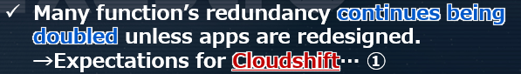
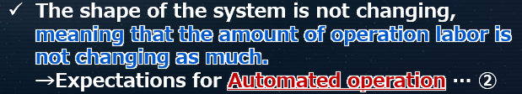
Introduction – What is “Offensive” and “ Defensive” Automation?
Hard to incorporate new technology
Frequently modified parts
Mobile
Social
IoT
5G
Mobile
Social
IoT
5G
Tech
Cut to cloud native
スケーラブルなアプリ
コンテナ
サービスメッシュ
イミュータブルインフラストラクチャ
宣言型API
Scalable apps
Containers
Service Mesh
Immutable infrastructure
Declarative API
Tightly grouped applications
Hard to do
Rebuilding apps
Inserting mechanics during the initial setup.
AP
Traditional static Environments
Offensive Automation
近代的でダイナミックな環境
パブリッククラウド
プライベートクラウド
ハイブリッドクラウド
Modern Dynamic Environments
Public cloud
Private cloud
Hybrid cloud
Defensive Automation
Manual Construction/Operation
PF
自動構築・自律運用
OP
Automatic Construction・Autonomous Operation
Monolithic
(CloudLift)
Cloud Native

Slide 9
How to proceed with “Offensive Automation”

Slide 10
How to proceed with “Offensive Automation”
By the way...
How does Cloud-Native work ?
What kind of mechanisms should we put in during the initial setup to make DevOps run smoothly?

Slide 11
How to proceed with “Offensive Automation”
What we can expect from Cloud Shift
The 11 Mechanisms (10 techniques＋Virtualization)
Steps to realizing Cloud Native
Raising ROI (Return on Investment)
CI(Continuous Integration)
Number of functions provided per unit time= increase in value
CD(Continuous Delivery)
Micro service Architecture
Improving investment quality to drive sales
Service Mesh
End goal
Providing high speed and scalable functions（Release）
Blue green deployment (Immutable Infrastructure)
Leveraging IT Resources and increase profits.
Declarative API
Improving OPEX efficiency
Reduction of operational labor costs
Auto scaling
Distributed tracing
Lower OPEX (Operation expenses) to invest
Metrics monitoring
Reduction of operational maintenance costs
Centralized management and Automated maintenance tasks
Virtualization (Free from Hardware life)

Slide 12
How to proceed with “Offensive Automation”
What we can expect from Cloud Shift
The 11 Mechanisms (10 techniques＋Virtualization)
Steps to realizing Cloud Native
Raising ROI (Return on Investment)
CI(Continuous Integration)
Number of functions provided per unit time= increase in value
CD(Continuous Delivery)
Improving investment quality to drive sales
Micro service Architecture
Service Mesh
End goal
Providing high speed and scalable functions（Release）
Blue green deployment (Immutable Infrastructure)
Leveraging IT Resources and increase profits.
Declarative API
Improving OPEX efficiency
Reduce operational labor costs
Auto scaling
These 6 steps directly relates to the biggest theme in Cloud nativeness:
Increasing ROI
Distributed tracing
Lower OPEX (Operation expenses) to invest
Metrics monitoring
Reduce operational maintenance costs
Virtualization (Free from Hardware life)

Slide 13
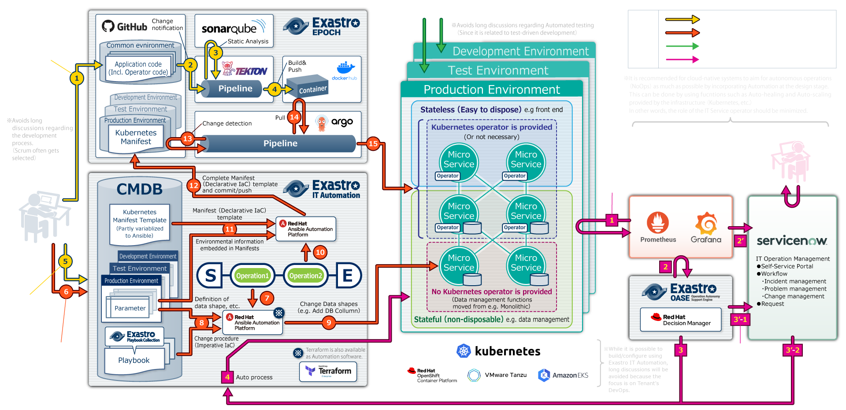
How to proceed with “Offensive Automation”
CI/CD Architecture with Kubernetes as base

Slide 14
How to proceed with “Offensive Automation”
Let’s template manage K8s manifest too (IaC) (Having a manifest for each movement is asking for bugs)
CI/CD Architecture with Kubernetes as base

Slide 15
How to proceed with “Offensive Automation”
の前半
(First half)
In the case of “Make-Believe containers” that are stateful and does not provide operators, users are forced to work on the release in a legacy manner before deploying it accordingly to the K8s Manifest.
It is best to eliminate as many of those containers as possible. At the same time, they should not be updated manually. (It is recommended to incorporate them into an automated job flow)
CI/CD Architecture with Kubernetes as base

Slide 16
How to proceed with “Offensive Automation”
(Second half)
If the k8s manifest (IaC) is commited and pushed, the environment will be updated according to the CD pipeline.
CI/CD Architecture with Kubernetes as base

Slide 17

How to proceed with “Offensive Automation”
(Reference)
The “non-ops” part of DevOps (Normal operations)

Slide 18
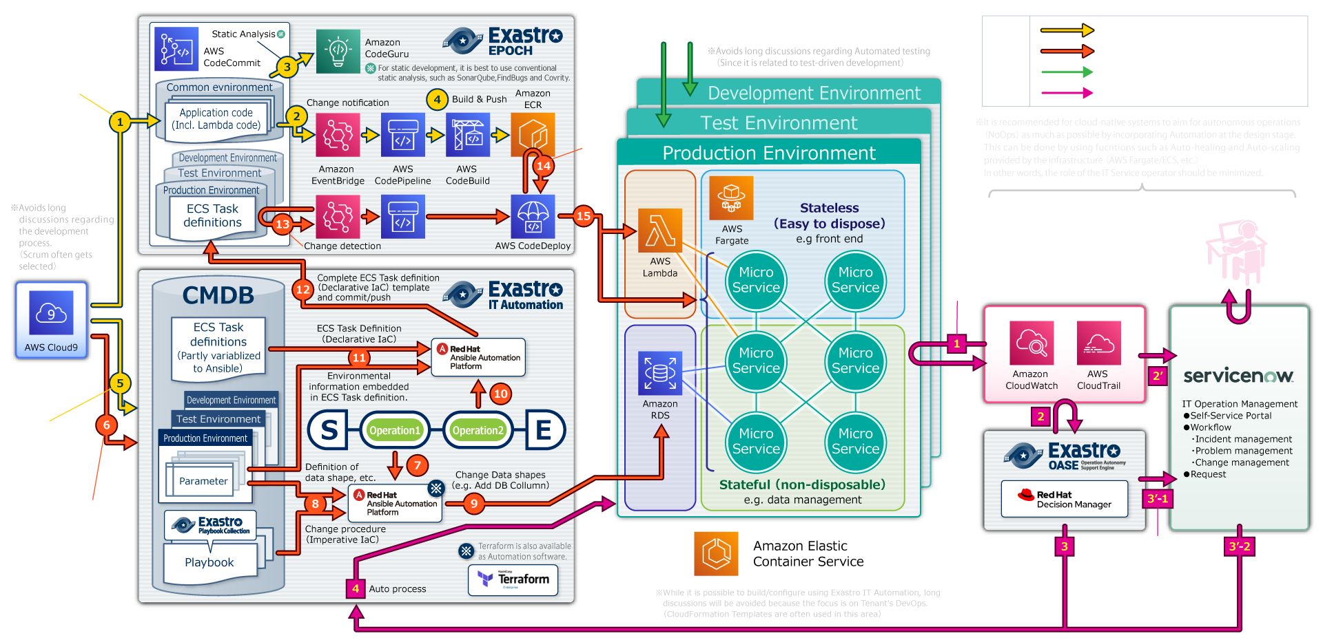
How to proceed with “Offensive Automation”
【Reference】A similar DevOps environment based on AWS ECS can be prepared

Slide 19
How to proceed with “Defensive Automation”

Slide 20




How to proceed with “Defensive Automation”
We summarized the voices of
IT engineers that works with SI for Monolithic systems.
Design
Delays and errors occurs when communicating between teams.
Double managing data and proprietary wording leads to errors in the design
Multiple development leads to complications with managing design documents (forms)
As a result, we are unable to check before and after the settings.
Preparation
Work orders between teams are complex. Each time a time chart is created, it gets discarded.
Every operation’s Manual is discarded after its created/reviewed.
Configurations are embedded in each procedure, and the number of patterns increases each time a new model/os is added (barrier to multi-vendor support)
Execution
Since the operations are done manually, the production time is inconsistent. ⇒People often have to wait before they can continue.
Since most of the operations are done manually, human error is inevitable.

Slide 21



How to proceed with “Defensive Automation”
We summarized the voices of
IT engineers that works with SI for Monolithic systems.
Insufficient Management
There is lack of understanding of which parameters can be changed and which parameters should not be changed during operation.
Current values of system parameter’s change history is not managed.
As a result, even though the parameters have been created, they are not being used in operations.
High burden
Systems are becoming more complex and the workload is only increasing.
Whenever something happens, we have to carefully execute one task at a time in a multi-person team while reading through a large number of manuals written in excel.
As a result, system downtime is longer and service gets affected.
Personal-ization
Work isn’t progressing due to the absence of experts.
When the experts disappears, the know-how disappears with them.
It is difficult to distinguish between known and unknown events, making us rely on the experience of experts.
As a result, experts cant be transferred.

Slide 22
How to proceed with “Defensive Automation”
People involved spend a lot of time trying to make sense out of the scattered information
Operation team
Only used once
Operation Procedure
(Embedded Parameters)
System’s Expected value
In charge of B
Operation Manual
パラ メータ
Op. proce -dure
In charge of A
パラ メータ
Para meter
パラ メータ
Op. proce -dure
Operator A
パラ メータ
Para meter
×
Time chart
In charge of C
Operator B
パラ メータ
Op. proce -dure
パラ メータ
Para meter
Design team
Expert
Operators
System
System status

Slide 23
How to proceed with “Defensive Automation”
People involved spend a lot of time trying to make sense out of the scattered information
Operation team
Only used once
作業手順
(パラメータ埋込み)
System’s Expected value
【Cause】 The system information is all over the place
In charge of B
Operation Manual
パラ メータ
Op. proce -dure
In charge of A
パラ メータ
Para meter
パラ メータ
Op. proce -dure
Operator A
パラ メータ
Para meter
×
Time chart
In charge of C
Operator B
パラ メータ
Op. proce -dure
パラ メータ
Para meter
運用者
Design team
Expert
System
System status

Slide 24
How to proceed with “Defensive Automation”
If we only could digitize and centralize the system information
SCM
In charge o fB
Parameter (CMDB)
Operation procedure
(IaC)
System’s expected value
In charge of A
In charge of C
Design team
Operation sequence (Change)
Operation sequence (Operation)
Operator
Operator
System
System status

Slide 25
How to proceed with “Defensive Automation”
If we only could digitize and centralize the system information
SCM
【Solution】 Centrally manage (Digitalize) System values and information.
In charge of B
Parameter (CMDB)
Operation procedure
(IaC)
System’s expected value
In charge of A
In charge of C
Design team
Operation sequence (Change)
Operation sequence (Operation)
Operator
Operator
System
System status

Slide 26

How to proceed with “Defensive Automation”
Exastro helps to digitize and centralize system information
SCM
In charge o fB
Parameter (CMDB)
Operation procedure
(IaC)
System’s expected value
In charge of A
In charge of C
Design team
Operation sequence (Change)
Operation sequence (Operation)
Operator
Operator
System
System status

Slide 27
Exastro Suite

Slide 28
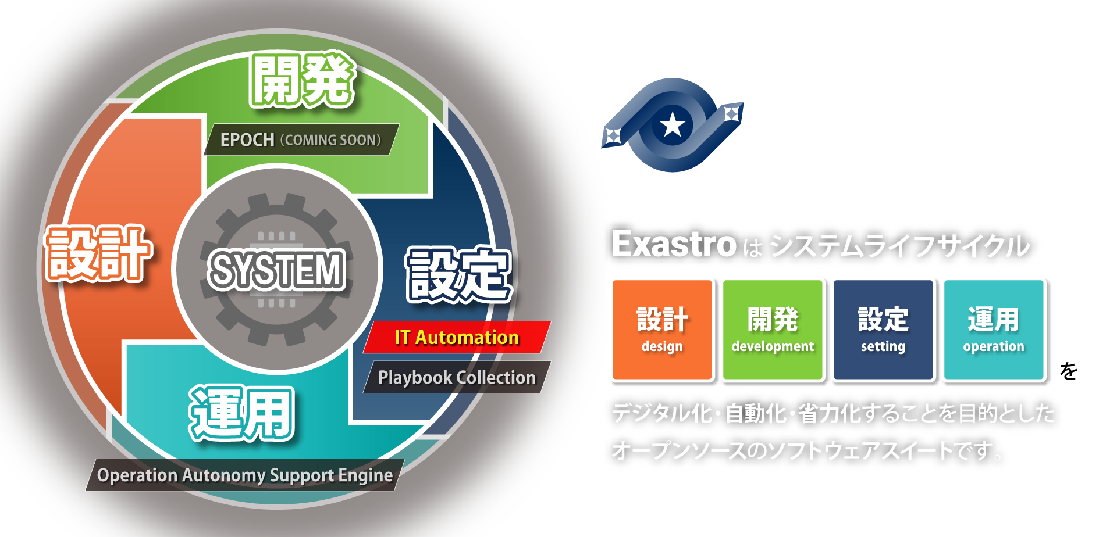




What is Exastro Suite?
Exastro is an open source software suite
for digitizing, automating and labor saving the system life cycle (design, development, setting and operation)

Slide 29
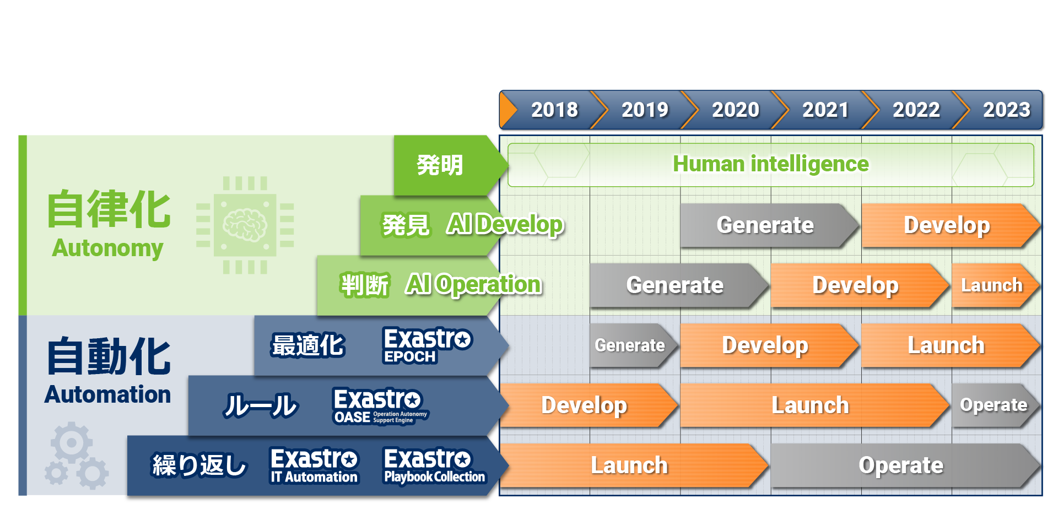
Roadmap of the Automation and Autonomy that Exastro Suite is aiming for
Roadmap of the Automation and Autonomy that Exastro Suite is aiming for
Invent
Discover
Decide
Optimize
Rule
Repeat

Slide 30

More information can be found on the Community site!
Exastro
https://exastro-suite.github.io/docs/index.html

Slide 31
Exastro IT Automation

Slide 32
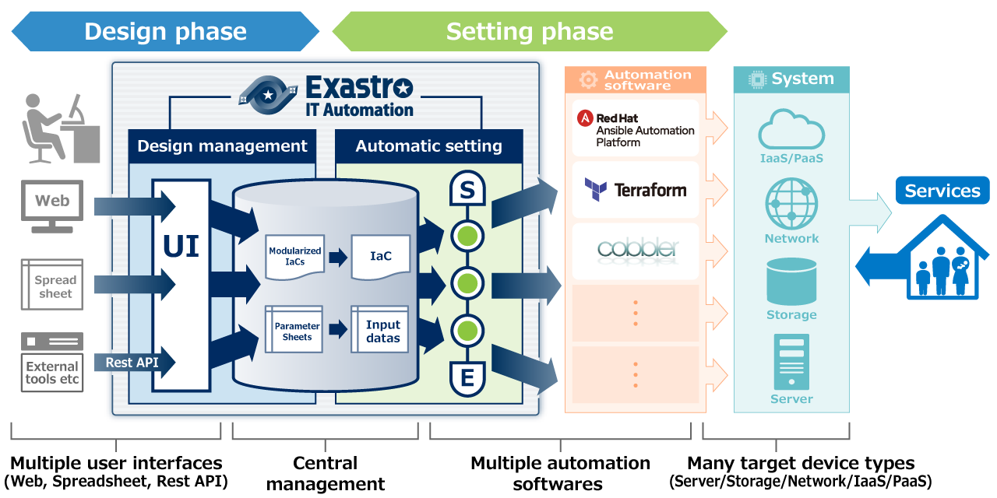
Exastro IT Automation：Framework for digitally managing system information.

Slide 33

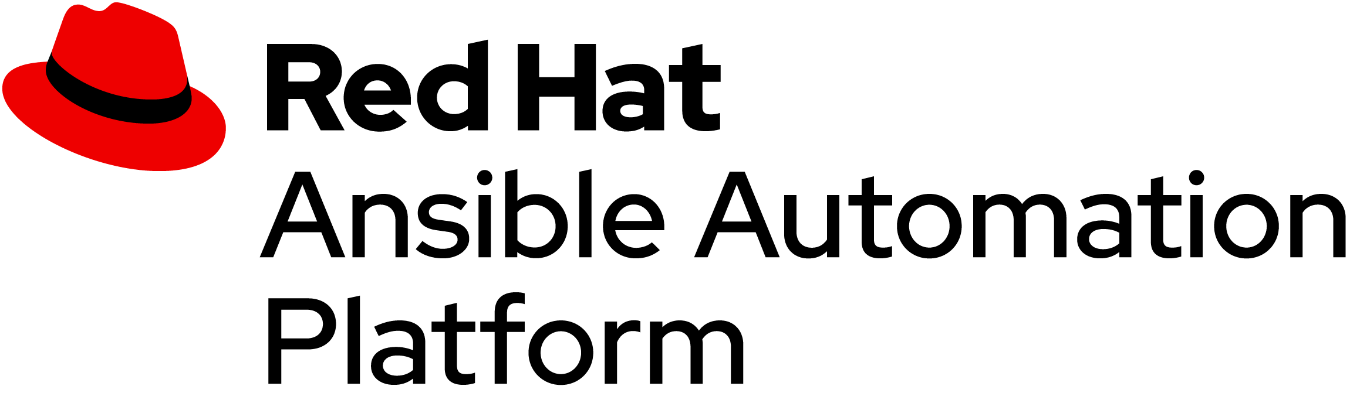
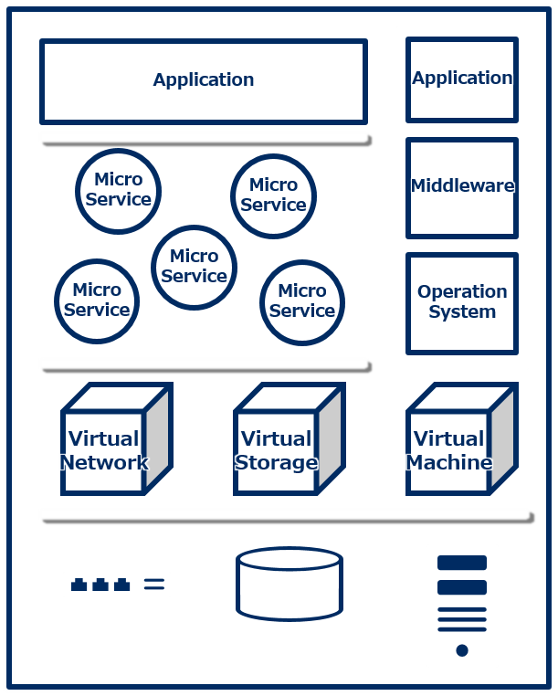
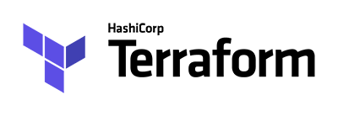

Exastro IT Automation：Merits of using system stacks
Method
System
CMDB
Application
Application
System Parameters
Micro Service
Micro Service
Middleware
PaaS
Controller
Micro Service
Micro Service
Micro Service
Operation System
IaaS
Controller
Virtual Network
Virtual Storage
Virtual Machine
Conductor (Job Flow)
Start
End
Hardware

Slide 34
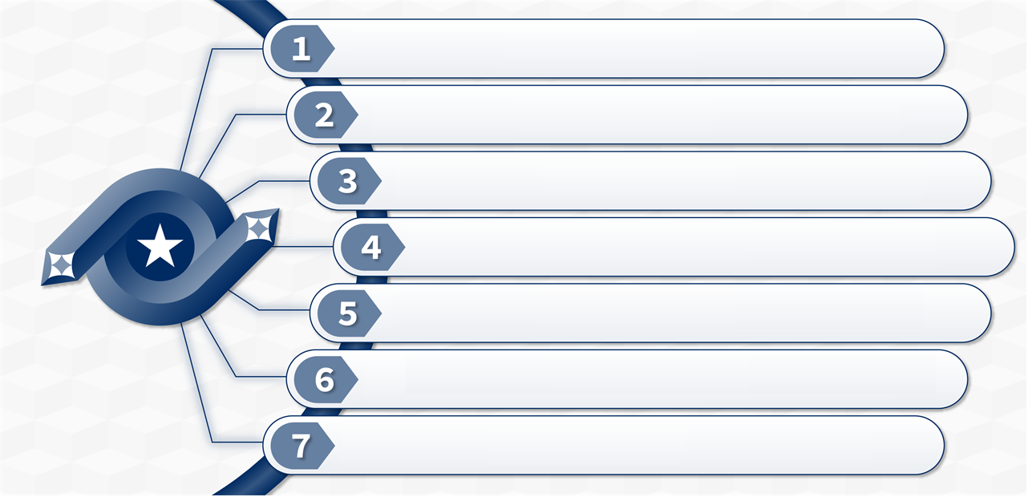
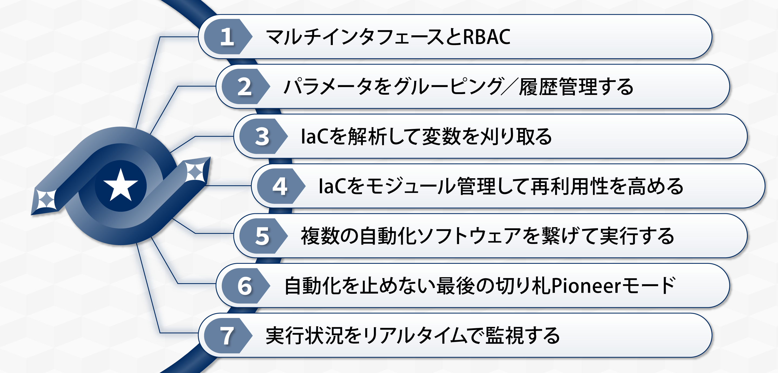
7 Features of Exastro IT Automation
Multiple user interfaces & Role Based Access Control
Function to manage parameters’ change history
Function to prevent typos of variable names
Function to improve the reusability of IaC
Function to control multiple automation tools
The last way to continue automation: pioneer mode
Real-time monitoring of execution status

Slide 35
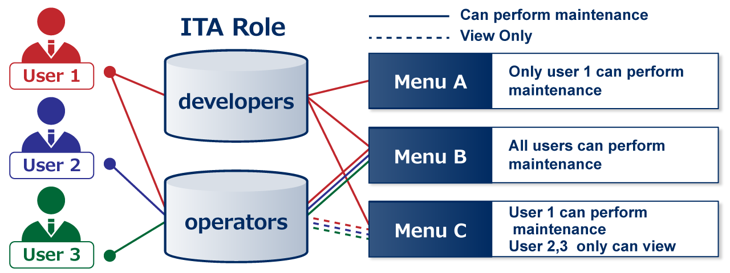
1st feature- Multiple user interfaces and RBAC
User operations can be executed from 3 types of interfaces(Web, Excel, RestAPI.
ITA also records operation information from all interfaces, such as「Who did it・when・what」. With Role based access control(RBAC), users can define roles, such as Developer, Operator and Users. They can also control what each role can do, such as “View Only, Update, and Execute.”

Slide 36
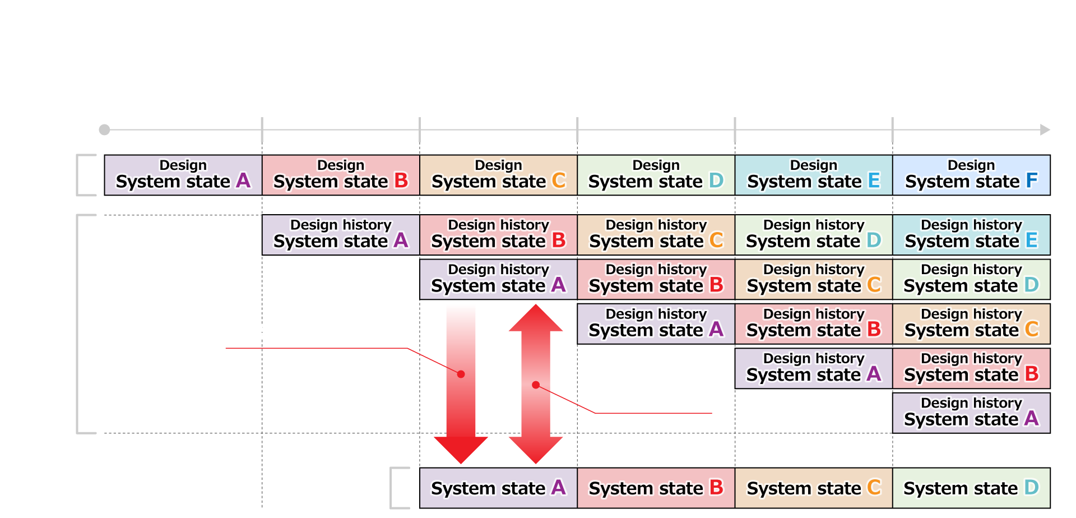
2nd Feature – Group and manage Parameters’ change history (1/2)
Group and manage System parameter information.

Slide 37
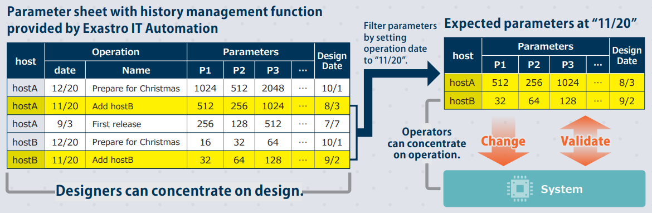
2nd Feature – Group and manage Parameters’ change history (2/2)
Parameter sheets come standard with history management function. The system uses the extracted info from the design history to update the system

Slide 38
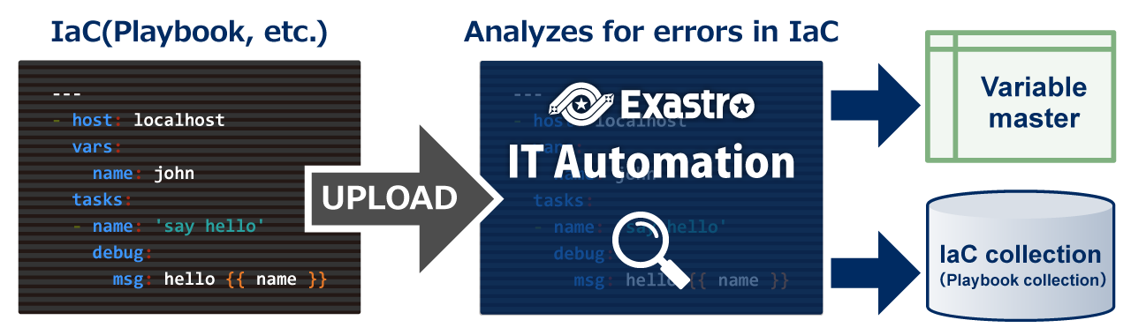
3rd feature- Preventing typos in variable names
When an IaC is uploaded in ITA, it will first be analyzed to check whether there are any errors in it.
If there are no errors, the variable names from the IaC description are obtained and then managed.
Since variable names are used in selection formulas, this prevents human error when typing

Slide 39
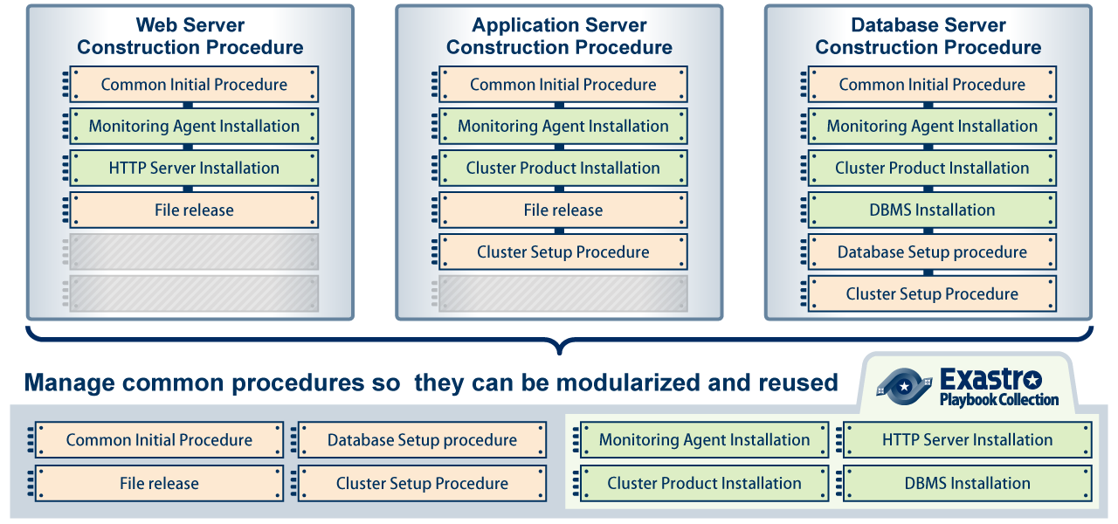
4th feature- Improve IaC reusability.
ITA can reuse IaC (Playbook, etc.) meaning that it can be used multiple time without being obsolete. They can then be modularized and assembled when you want to use them

Slide 40
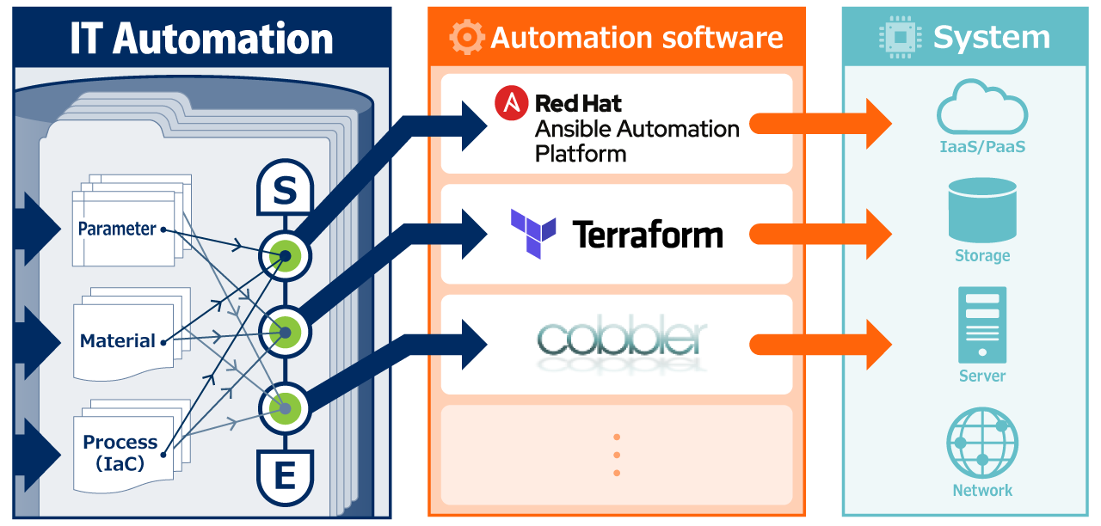
5th feature – Control multiple automation tools
In ITA, users can connect multiple automation software to work in a single work flow.
Additionally, input data necessary for operating different automation software will automatically be generated. E.g) For Ansible, the required playbooks will be gathered and connected. Then it will create host_vars from the parameters for each node.
Imperative IaC
Declarative IaC

Slide 41
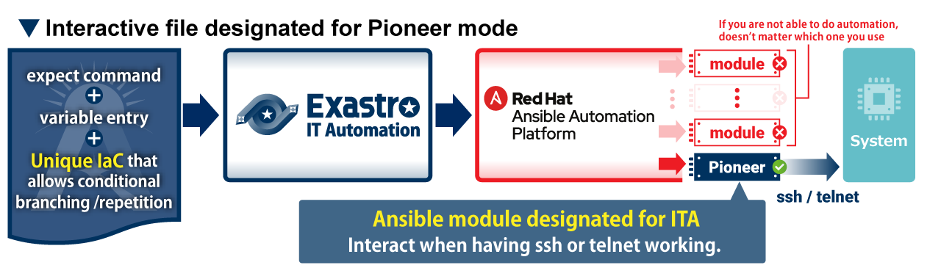
6th feature – The trump card for automating – Pioneer mode.
If users are unable to automate using any of the Ansible modules, they will only experience half of the benefits that automation can deliver.。Therefore, ITA offers Pioneer mode, which can act as a trump card when automation does not work.

Slide 42
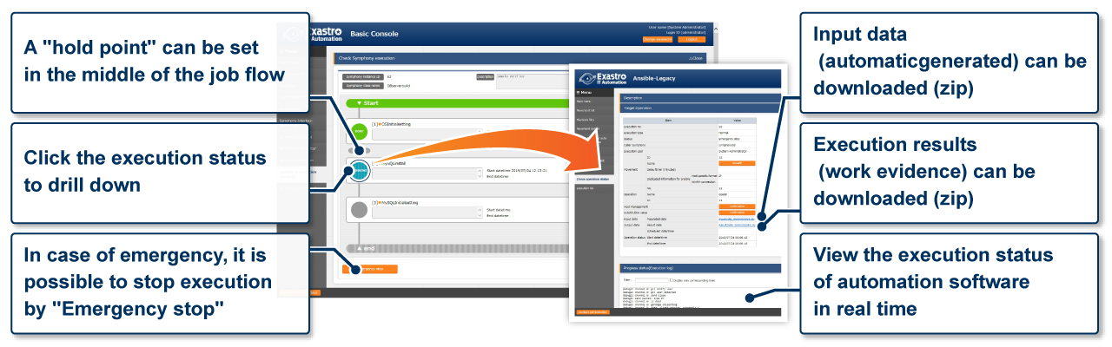
7th feature：Real-time monitoring of Execution status
In comparison to manual operations, ITA puts great emphasis on real-time monitoring of execution status It also manages execution records/results (operation evidence) and allows users to download them.

Slide 43
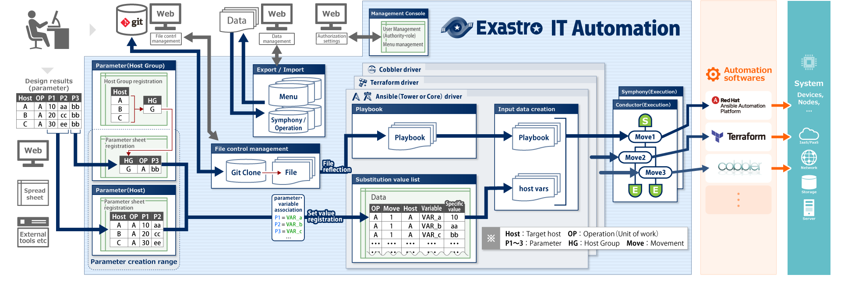
Detailed overview
In addition to the 7 features mentioned above, we have devised various other ways to digitally manage system information.
②
⑤
⑦
④
③
⑥
①

Slide 44
Exastro OASE

Slide 45
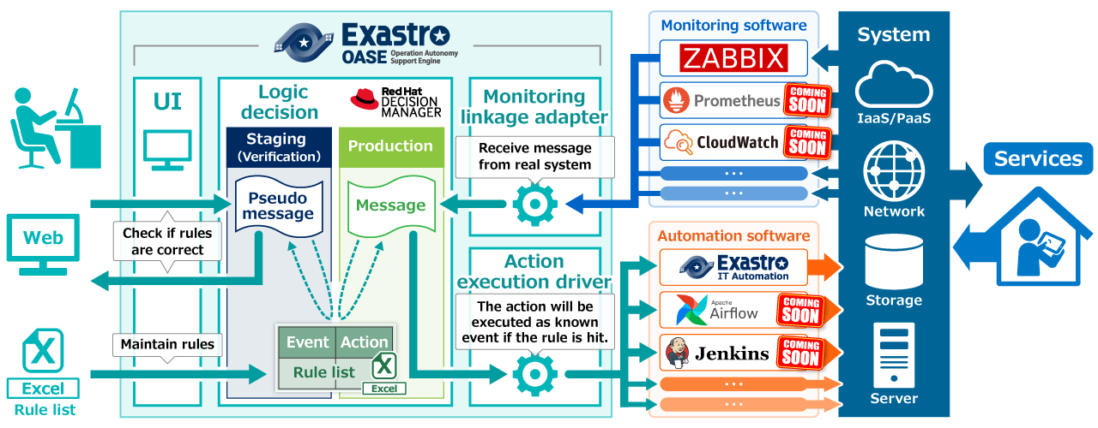
Detailed overview
Exastro OASE (Operation Autonomy Support Engine) is a software that supports Autonomization of system operations.

Slide 46
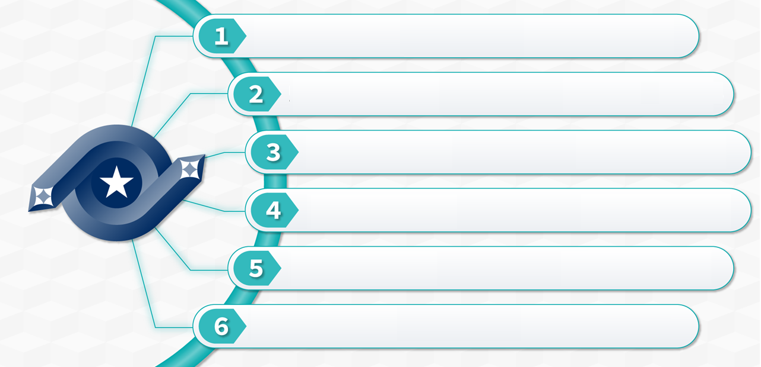
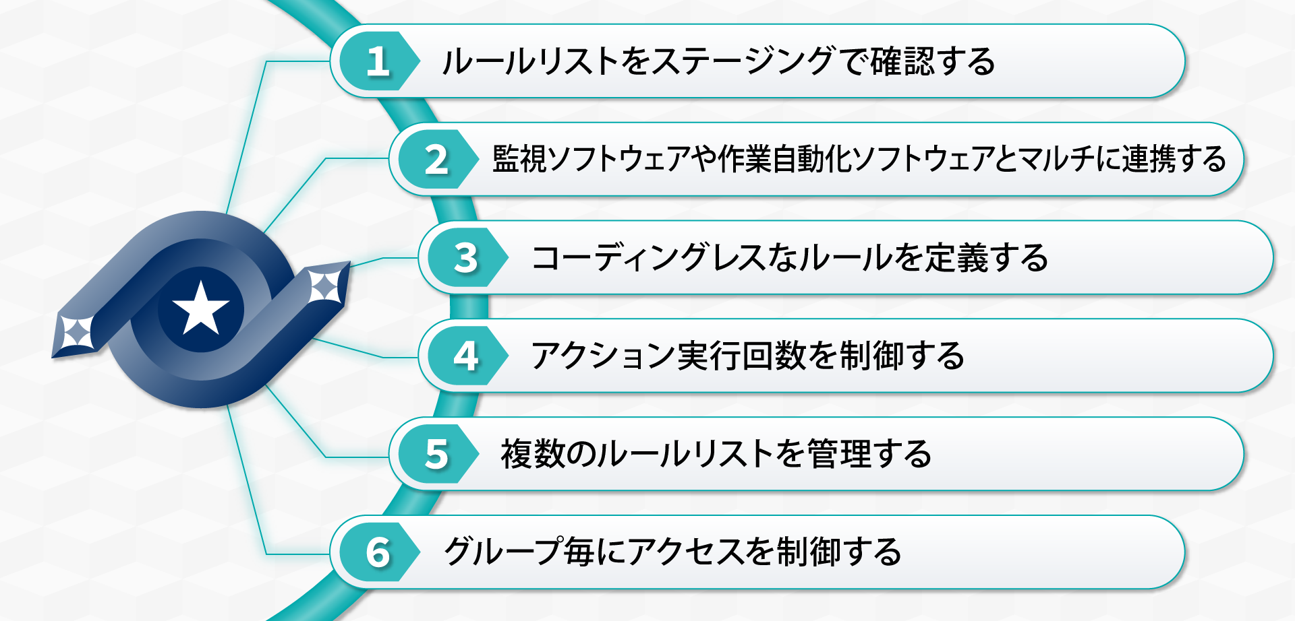
6 Features of Exastro OASE
Rule list confirmation in staging environments
Linking multiple monitoring and automation software
Codeless rule defining
Controlling the number of executions
Managing multiple rule lists
Role-based access control

Slide 47
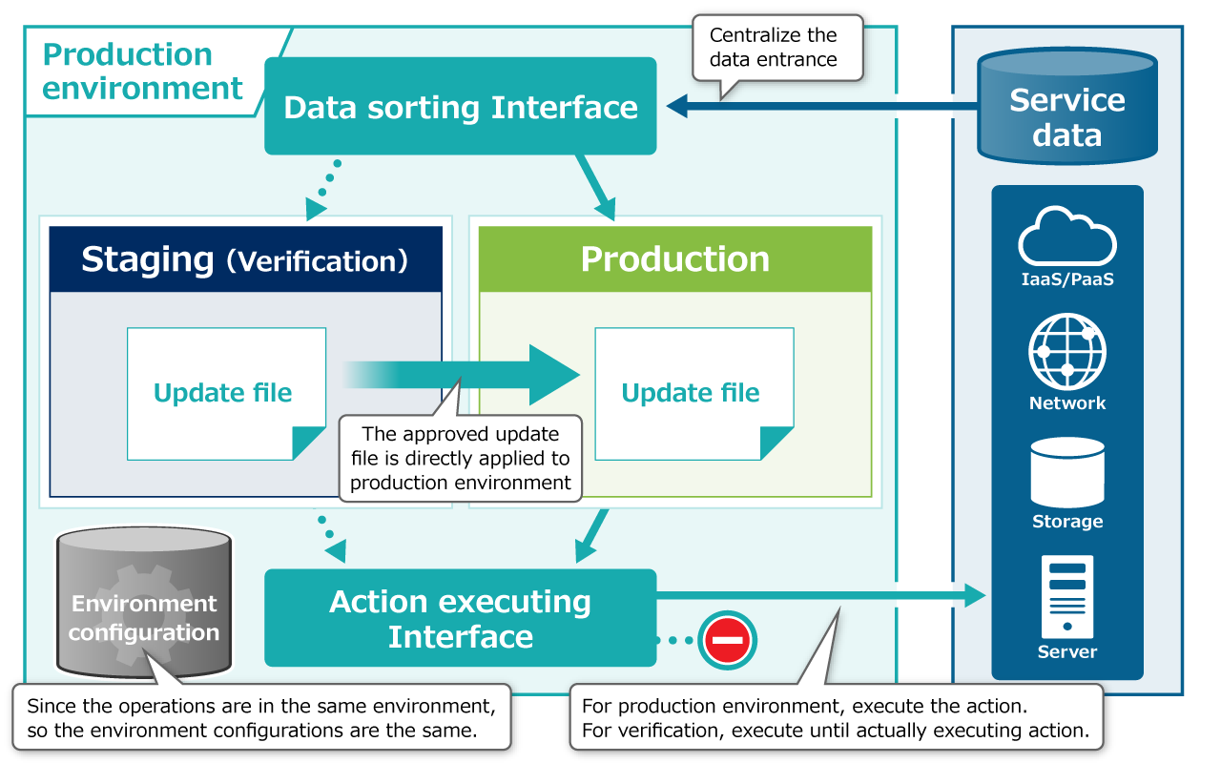
1st feature –Rule list confirmation in staging environments
Staging environments can be used to check the validity of the execution before applying to rule lists.

Slide 48
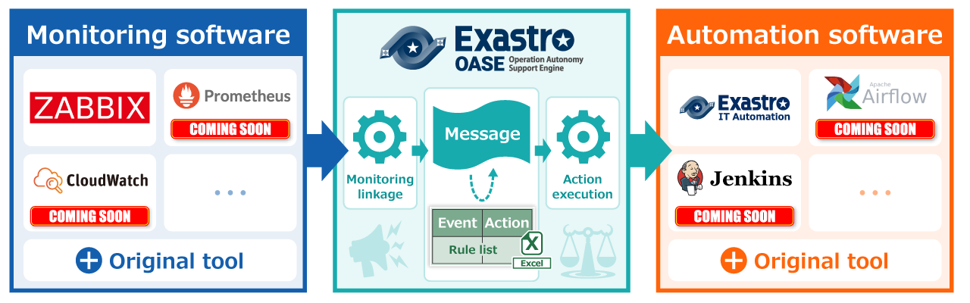
2nd feature – Linking multiple monitoring and automation software
OASE is equipped with drivers and RestAPI for linking with a variety of tools, allowing for linkage with multiple softwares.

Slide 49
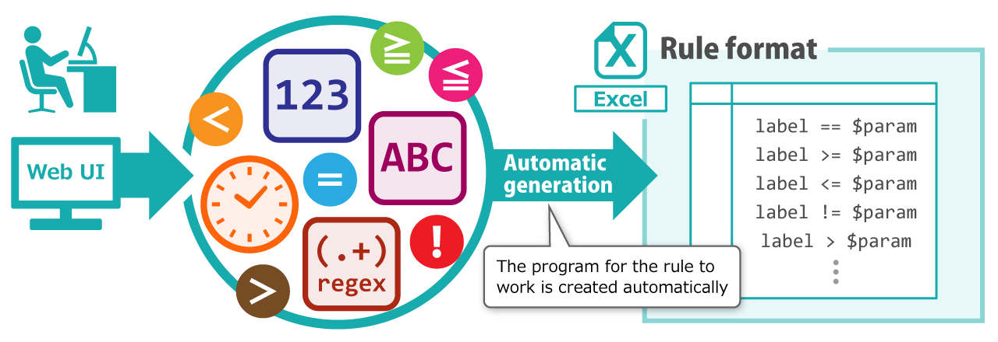
3rd feature – Codeless rule defining
OASE uses Excel for ruling format. It is possible to create an excel file with an automatically written program from the Web UI. In other words, define rule without any coding.

Slide 50
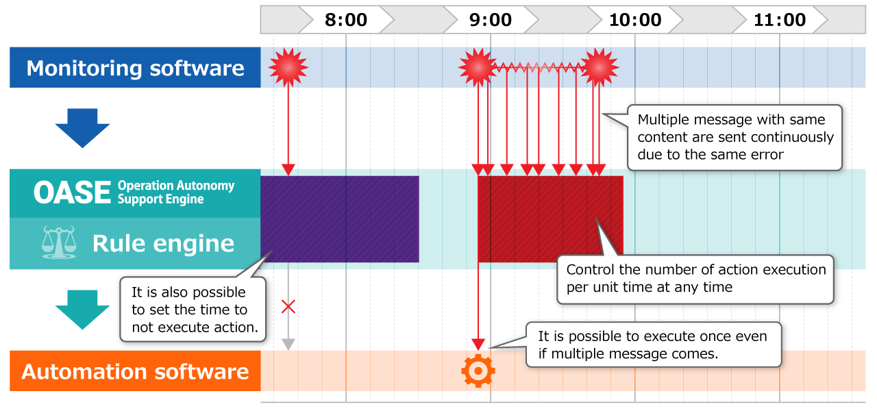
4th feature – Controlling the number of executed actions
Even if the user is receiving multiple messages from the monitoring tool, it is possible to set the number of executions and the execution interval according to the user’s need.

Slide 51
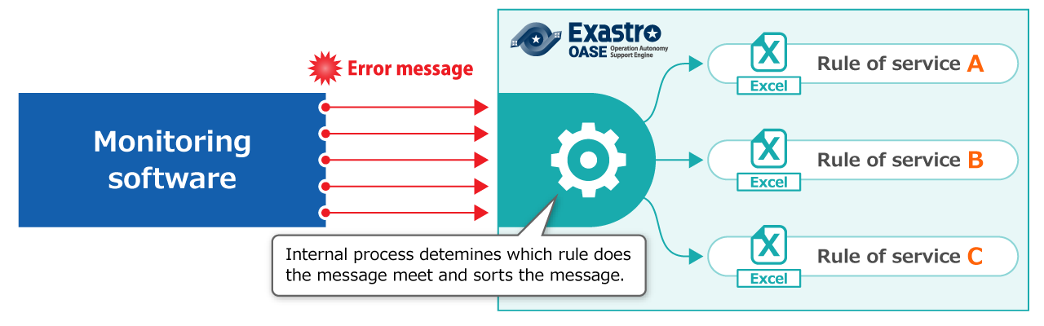
5th feature – Managing multiple rule lists
Rules can be divided into units, such as “by project” or “by system” and manage them. It is also possible todistribute messages according to the divided rules.

Slide 52
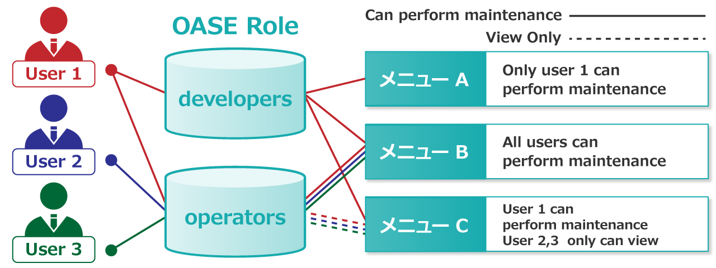

6th feature – Role-based access control
With Role-based Access control (RBAC) users can assign and manage roles (Reference/Update/Execute) for each group
Menu A
Menu B
Menu C

Slide 53
Approach to AIOps
Rule-base is effective for early automation/saving labor of frequently occurring events.
On the other hand, we can expect AIOps to further automate and save labor beyond the early stages. However, as it requires training data for the AI to read, it takes time to start up.
Exastro OASE supports the realization of AIOps by gathering process results while producing results in rule-based automation.
System
Auto process A
Process results
Automatic judgement (OASE)
Monitoring Software
Auto process B
Rule list
(Rule based)
Auto process C
Knowledge gained from human knowledge and experience
Manually set up
Improve accuracy with AI
Visualize
AIOps
Analyze

Slide 54
Case

Slide 55
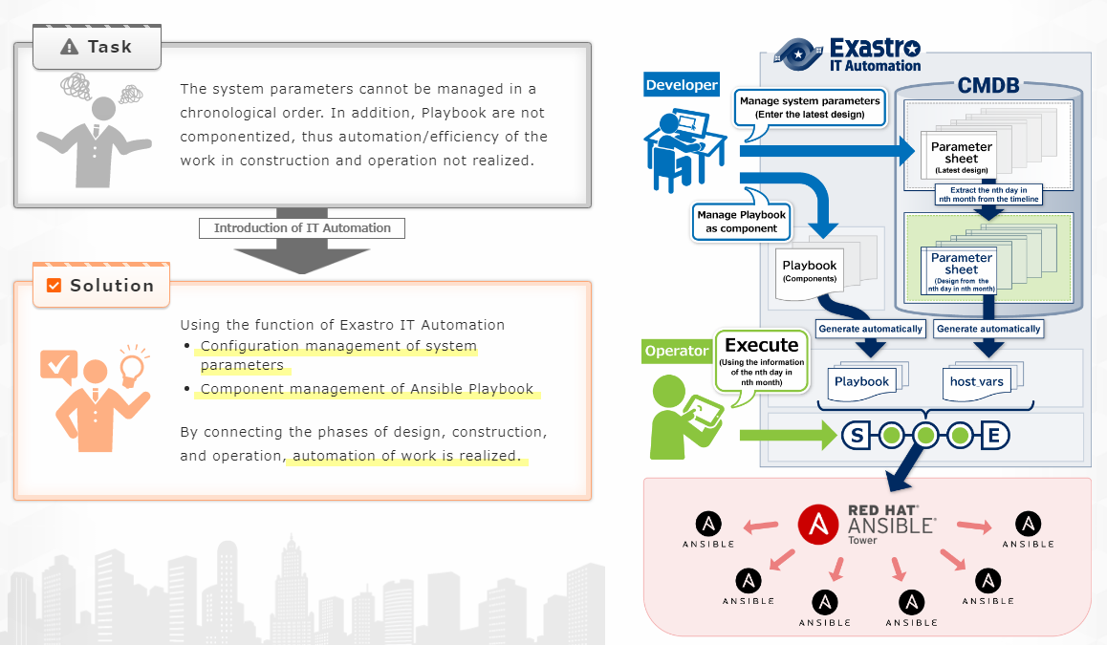
【Case 1】Streamlining various operation monitoring settings for a large-scale system(1/2)

Slide 56
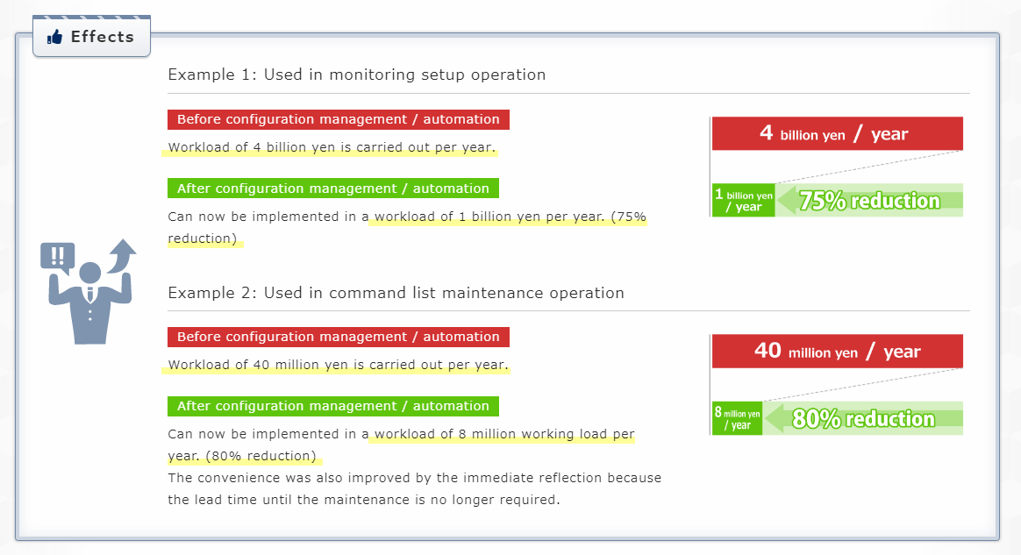
【Case 1】Streamlining various operation monitoring settings for a large-scale system(2/2)

Slide 57
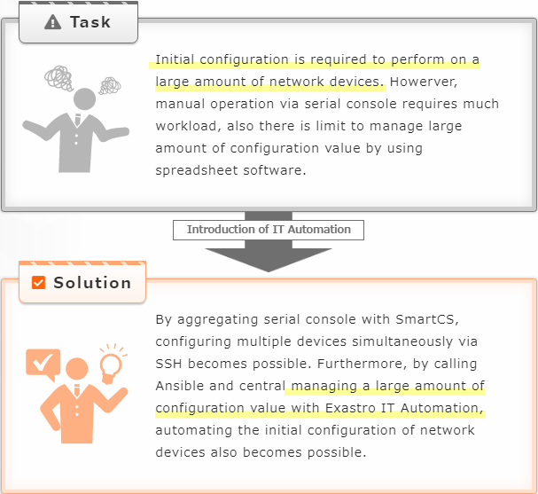
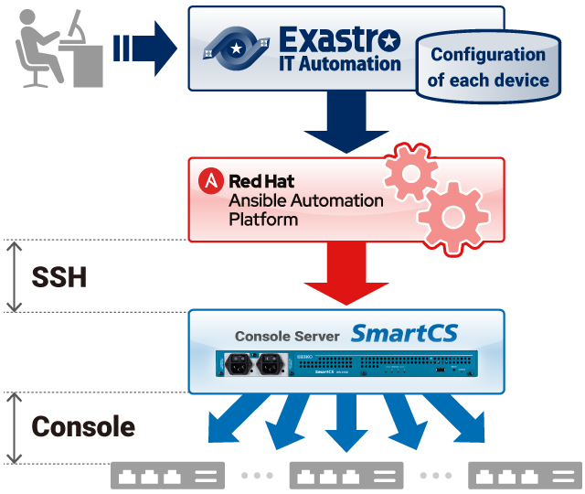
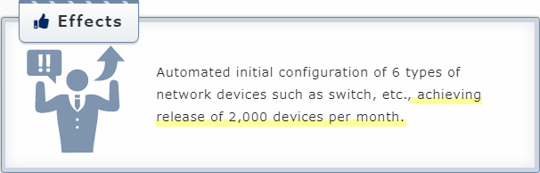
【Case 2】Automatic kitting 30 000 devices for a large-scale event.

Slide 58
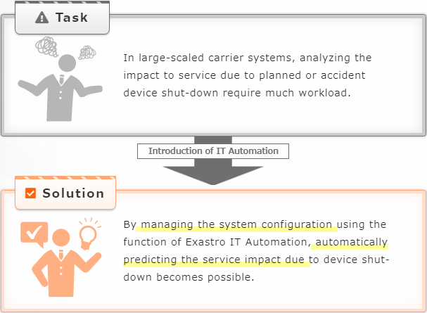
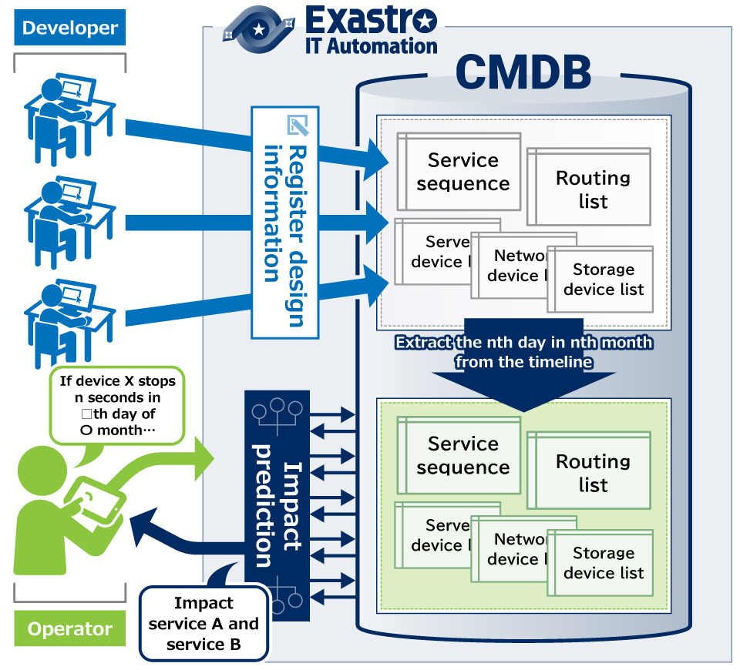
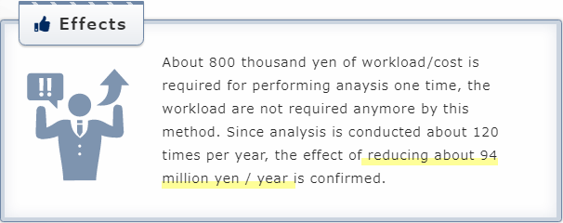
【Case 3】Using system configuration lists to predict service impact of equipment outages.

Slide 59
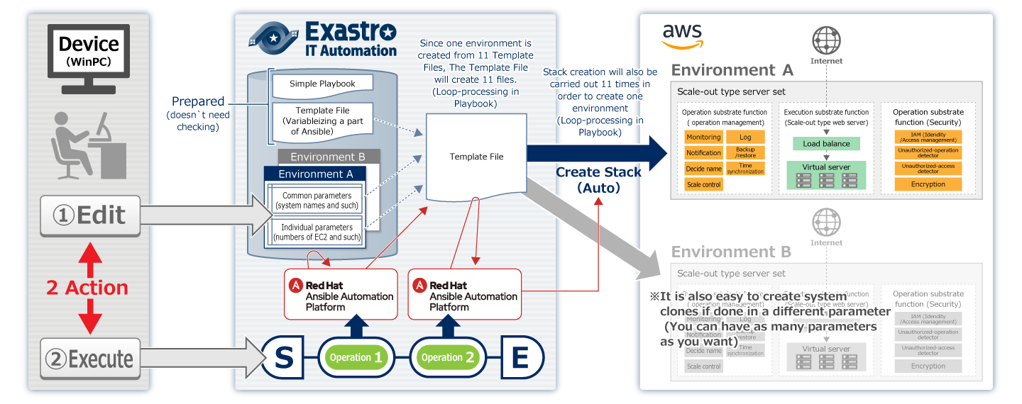
【Case 4】How corporation`s operation division controls each division`s AWS system (1/2)
Exastro IT Automation managed a “CloudFormation template” and provided a mechanism that delivers a well-governed AWS environment to each department.

Slide 60
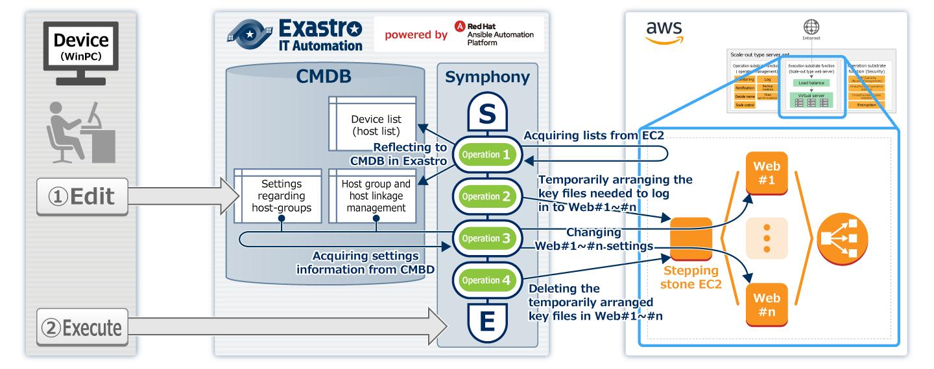
【Case 4】How corporation`s operation division controls each division`s AWS system (2/2)
It also provided support for operational scenarios such as emergency patching of an running EC2 (Autoscale)

Slide 61
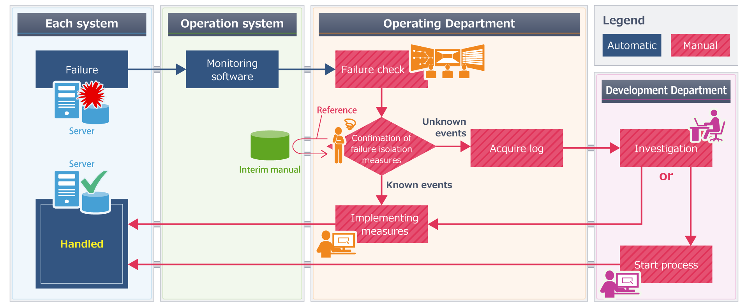
【Case ⑤】Automated fault handling in operational tasks －Before－
The whole operation of handling problems had to be done manually.

Slide 62
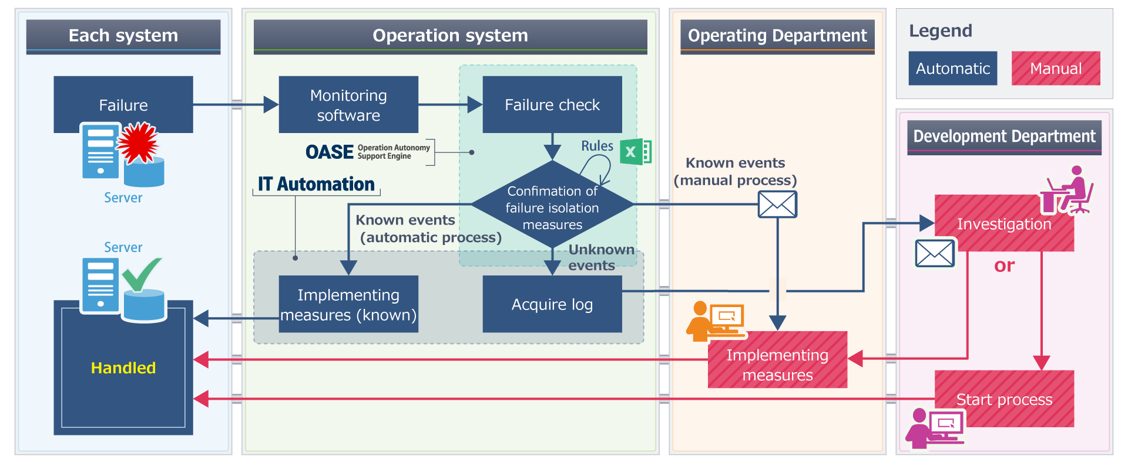
【Case ⑤】Automated fault handling in operational tasks －Before－
We were able to minimize the amount of manual labor by using Exastro

Slide 63
Reference 1) Our goal of making Exastro OSS
参考

Slide 64
Our goal of making Exastro OSS.
Ref.
The aim of making Exastro Suite OSS was to be able to share it widely in the current market and collaborating with other software and it’s developers to solve the “pain” of IT Engineers.
NEC has developed IT Automation, a software that supports automating system construction and released it as an open source software (OSS) in April 2019. One of the challenges of building large-scale systems as been the repetition of manual routine tasks, such as setting up the devices that make up the system, as well as the variation of quality and efficiency of the workers. NEC has been building and developing mission-critical large scale-systems and has accumulated SI knowledge and experience. Exastro IT Automation is a software built to handle problems built from that same experience and previous knowledge and have been using it to automate a wide variety of system construction projects. However, recently, large-scale system construction have been done by multiple companies, meaning that the need for automation tools, such as Exastro IT Automation, is increasing. By making Exastro IT Automation OSS, we aim to share it widely in the market and form an ecosystem in collaboration with other software to create a new business model where we can practice social value creation.
Source：http://www.news2u.net/releases/165517/
Note：Old name「astroll IT Automation」は「Exastro IT Automation」に書き直している

Slide 65
Reference2) Offensive and Defensive Automation
Ref.

Slide 66
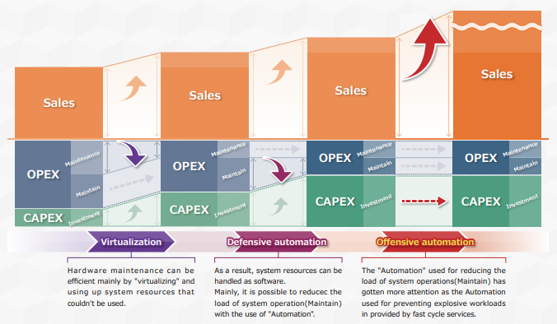
【Offensive and Defensive Automation】Virtualization/Automation and transition to CAPEX/OPEX (1/3)
Ref.
The 2 different areas of automation have different objectives. Even from a financial perspective.

Slide 67
【Offensive and Defensive Automation】Virtualization/Automation and transition to CAPEX/OPEX (2/3)
Ref.
Defensive automation often aims to improve OPEX efficiency (maintenance costs).

Slide 68
【Offensive and Defensive Automation】Virtualization/Automation and transition to CAPEX/OPEX (3/3)
Ref.
Offensive automation often aims to increase ROI (Return on Investment)

Slide 69
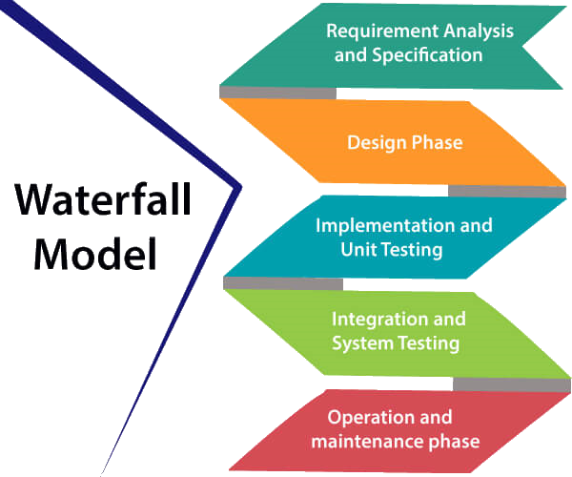
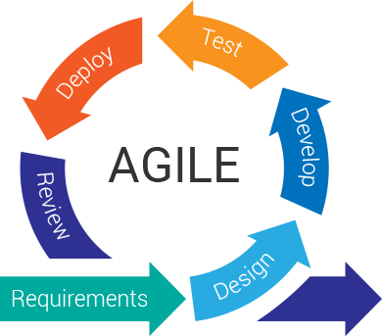



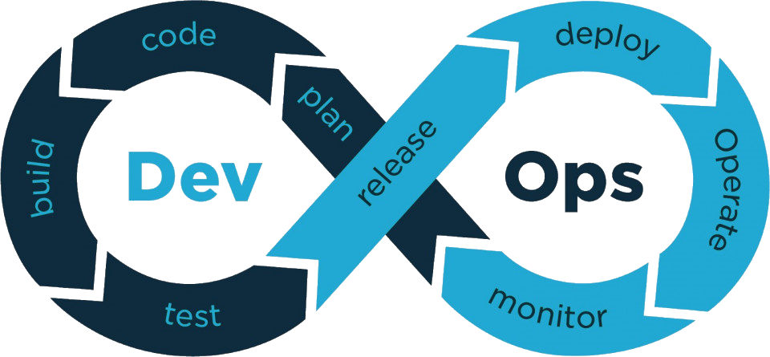









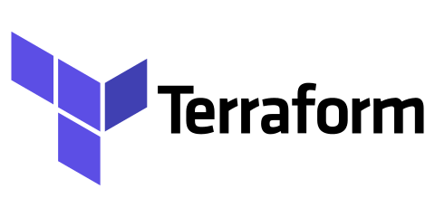
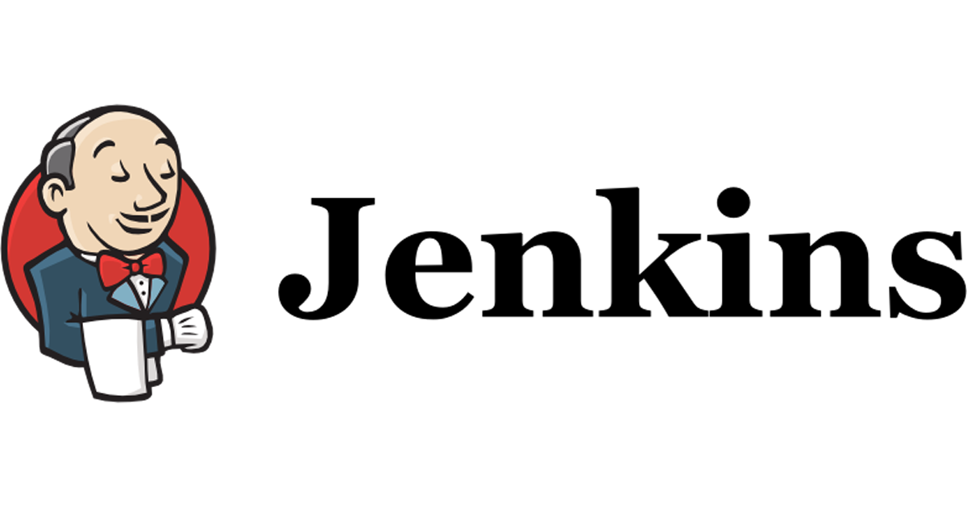



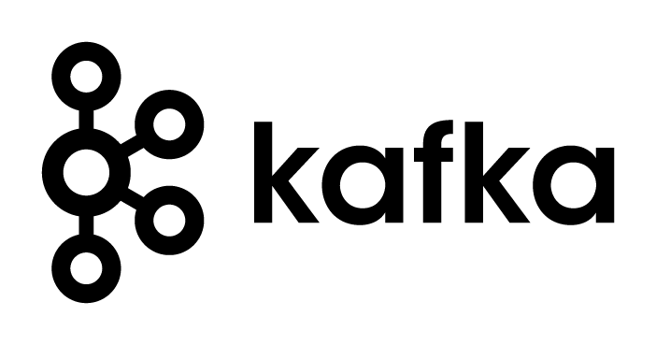



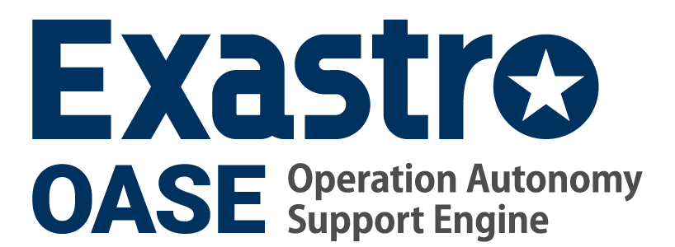










【Offensive and Defensive Automation】The situation surrounding the systems and Exastro’s position
Ref.
Monolithic
Cloud Native
Lift
Shift
on-premise
Cloud
Cloud
tenancy
Operation/ Construction
Operation/ Construction
tenancy
Close apps
Close apps
Scalable apps
Static Environment
Static Environment
Dynamic environments
運用 (ITIL)
運用 (DevOps)
Cloud Platform
Cloud platform
Supports Service speed
Uses Packages and managed services to limit the scope of the maintenance
Efficiently using resources
Leave HW Migration

Slide 70

【Offensive and Defensive Automation】Automating Monolithic/Cloud native hybrid systems
Ref.
Exastro ITA centrally manages information for the whole system, not separately.
Centrally manages System information
Imperative IaC(Continuous)
Declarative IaC (Declarative API)
Monolithic Architecture
Persistent data
(cannot be deleted)
Immutable
(easy to dispose)
Cloud native Architecture
Carve out frequently modified parts of the system to be cloud-native
Whole system(Hybrid)
Defensive Automation
Offensive Automation

Slide 71
Reference 3) Offensive Automation
参考

Slide 72
【Offensive Automation】Blue green deployment and construction/migration(1/2)
Ref.
Blue green deployment partially repeats “new builds”. If done manually, the amount will be too much to handle, so an automatic construction is a must.
Step1 | Step2 | Step3 | Step4
Production environment only | Create new environment (test) | Return persistent data to true data | Release new environment by switching system and replacing data
Blue side
（Production）
Persistent data(old)
Persistent data(old)
Persistent data(old)
Switch
Green side
（New production）
Two new “builds” are required for one release (Repeatability is important)
Switch
Persistent data(new) (for test)
Persistent data(new)
Blue side mirror
（collateral cut back）
Persistent data(new) (for test)
There also migration tasks other than “new build” (must be automated)
※Need to maintain compatibility and verifiability to keep it switchable.

Slide 73
【Offensive Automation】Blue green deployment and construction/migration(2/2)
Ref.
Declarative APIs (that defines) are the best for “new builds”
On the other hand, the “migration work” needs to be automated with imperative IaC.
Declarative IaC
(Declarative API)
New system
Imperative IaC
(Continuous)
Persistent data (new)
The final result will be as following
1 of 〇〇
2 of □□
3 of △△
Prepare 1 of
Mix A and B to create 3 of △△
Mix C and D to create 2 of□□
Migration operation
New construction
There is a need to automate operations with Imperative IaC (Except for cloud resources)
Declarative IaC suits building new cloud resources
Persistent data (old)
Current system

Slide 74
Reference 4) Defensive automation
参考

Slide 75







【Defensive Automation】Overview over the Automation and Autonomy Exastro suit is aiming for.
Ref.
Design
Develop/Construct
Operate
Replication
ITSM/ITOM Softwares
(e.g. )
input
Playbooks (modularized)
Files
and
Templates
kick/Controll
AI
Technology
Devices
Parameter Lists
Input data Generator
kick/Controll
Rule
List
known
Unknown
Input datas
Playbooks (combined)
HostVars files
Automation Softwares
(e.g. )
Monitoring Software
(e.g. )
System

Slide 76

【Defensive Automation】Narrow automation streamlined by the release process.
Ref.

Slide 77

【Defensive Automation】Defensive automation – wide automation brought by central managed system information.
Ref.

Slide 78

【Defensive automation】 Guidebook for improving system Construction/Operation(1/5)
Ref.

Slide 79
【Defensive automation】 Guidebook for improving system Construction/Operation(2/5)
Ref.
These problems can generally be solved in 3 steps
設計
チーム間の情報伝達に遅延やミスが発生する
データの二重管理や独自文言が設計ミスにつながる
多重開発により設計書(帳票)の管理が煩雑化する
結果として設定の前後性を確認できない
Design
Step 1
Centrally manage Design info
Solution
Design info
Step 3
Link centrally management and automated execution.
CMDB
Design info
Design info
チーム間の作業順序が複雑で毎回タイムチャートを作成しては使い捨てる
作業ごとに手順書を作成/レビューしては使い捨てる
手順ごとにコンフィグを埋め込んでいて、新機種／新OSを追加するごとに手順書のパターンが増える(マルチベンダー対応の障壁)
作業準備
Link
Preparation
Design Info
Job
Execute
Step 2
Realize automated Executions
CMDB
Design Info
Design Info
Job
Solution
Job
作業実施
人手作業なので作業時間が一定でない ⇒チーム間で作業待ちが発生
人手作業なので人為ミスの懸念から逃れられない
Execution
Job
Execute
Job
Job

Slide 80












【Defensive automation】 Guidebook for improving system Construction/Operation(3/5)
Ref.
More specifically, it can be solved with 12 smaller tasks.
Step 1
Step 2
Step 3
5 tasks
5 tasks
2 tasks

Slide 81

【Defensive automation】 Guidebook for improving system Construction/Operation(4/5)
Ref.

Slide 82





【Defensive automation】 Guidebook for improving system Construction/Operation(5/5)
Ref.
The guide can be downloaded from the OSS Community site
Exastro IT Automation Community site: https://exastro-suite.github.io/it-automation-docs/index.html

Slide 83
Reference 5) Ecosystem and related software
Ref.

Slide 84



Exastro IT Automation：Where to use Automation software (cloud, etc.)
Conductor (Job Flow)
System
SaaS
Application
CMDB
Start
Red Hat Ansible Tower
Red Hat Ansible Engine
Ansible driver
Movement
Ansible Integration Function
PaaS
Middleware
Playbook 部品
Playbook 部品
Playbook part
or
(Playbook part order)
ITA Ansible Agent
OS
Can freely define
パラメータ シート
パラメータ シート
System parameter
IaaS
Physical devices
Terraform driver
Movement
Terraform Integration Function
Organization
Playbook 部品
Playbook 部品
Terrraform Template part
WorkSpace α
(Terraform parts used)
State File
Terraform Binary
Playbook 部品
Playbook 部品
Terrraform Policy File
WorkSpace β
State File
Terraform Binary
End
…
Public
OnPremise

Slide 85


Exastro IT Automation：Where to use Automation software (Vmware Infrastructure)
Conductor (Job Flow)
System
Application
CMDB
Start
Red Hat Ansible Tower
Red Hat Ansible Engine
Red Hat Ansible Engine
Ansible driver
Movement
Ansible Integration Function
Middleware
Playbook 部品
Playbook 部品
Playbook part
or
(Playbook part order)
ITA Ansible Agent
OS
Can freely define
パラメータ シート
パラメータ シート
System parameter
(This can also be controlled)
Terraform driver
Movement
Terraform Integration Function
Organization
Playbook 部品
Playbook 部品
Terrraform Template part
WorkSpace α
WorkSpace α
Terraform Binary
(Terraform parts used)
State File
Terraform Binary
Playbook 部品
Playbook 部品
Terrraform Policy File
(vSphere, vSAN, NST-t, vRA7, …)
WorkSpace β
WorkSpace β
Terraform Binary
State File
Terraform Binary
End
…
VMware Cloud
on AWS
OnPremise (HCI)

Slide 86

Joining the Red Hat Kubernetes Operator Project
Ref.
Software certified by Red Hat OpenShift Operator is guaranteed to be able to run on OpenShift, enabling multi-cloud support and autonomous operation through the codification of operational know-how.
Source：https://www.redhat.com/ja/about/press-releases/red-hat-starts-kubernetes-operator-project-in-japan

Slide 87

Benefits of linking Exastro ITA and Ansible Tower
Ref.

Slide 88



Role sharing between Exastro ITA and ITOM (e.g. ServiceNow)
Ref.
Construction
Operation prep
Operation
CMDB
CMDB
Operator
Common info for Construction and Operation
Information only used for construction
Work Flow
Common info for Construction and Operation
Information only used for construction
Work Flow
Constructor
Register/Edit Parameter
Run Conductor
Initial Transition
Replication
Kick
Constructor
Operator
Discovery
Conductor (Job Flow)
Conductor (Job Flow)
Conductor (Job Flow)
CMDB
Start
CMDB
Start
CMDB
Start
Common info for Construction and Operation
Information only used for construction
Common info for Construction and Operation
Information only used for construction
Common info for Construction and Operation
Information only used for construction
End
System
End
System
End
System

Slide 89
Reference 6) Setting Samples
参考

Slide 90

Exastro IT Automation：The thought behind Setting Samples.
Line up cartridge type system templates as Setting Samples.
Line up system templates and turn the SI into menus (Cartridge type)
System Templates
Deploying SI Menus to various cloud environments
1st
2nd
3rd
4th
5th
6th
・・・
Exastro pursues ease of use as an execution base for system templates
System Template (3rd model)
・・・

Slide 91

Exastro IT Automation：Effects of incorporating Settings Samples
Effects of incorporating Setting Samples (1st model)

